Slide 1
smart glasses

Slide 2
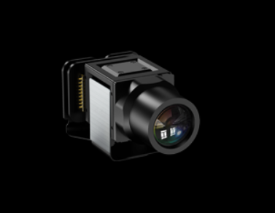
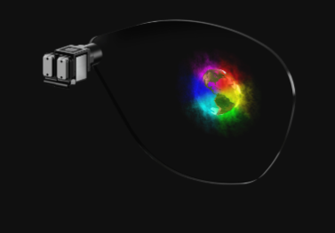
I vision
integrated display composed of micro Led projector and waveguide optics
https://www.jb-display.com

Slide 3
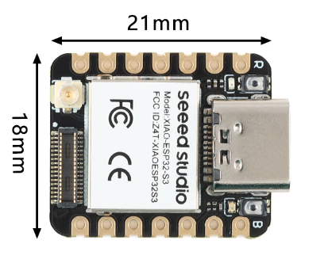
II core
the useful processor can be a small esp32 that uses little battery but with all the necessary connectivity
https://github.com/Mjrovai/XIAO-ESP32S3-Sense

Slide 4
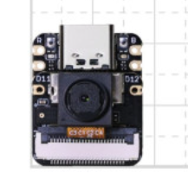
III camera
a small camera that has the power to transmit with little latency at a quality sufficient to allow tracking

Slide 5
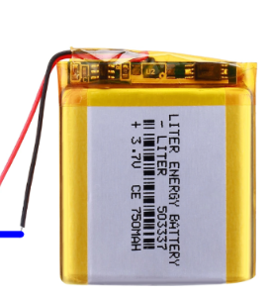
IV battery
the idea is to have an easily changeable battery that can be charged in the case of the glasses where more than 3 continuously charging batteries will be inserted

Slide 6
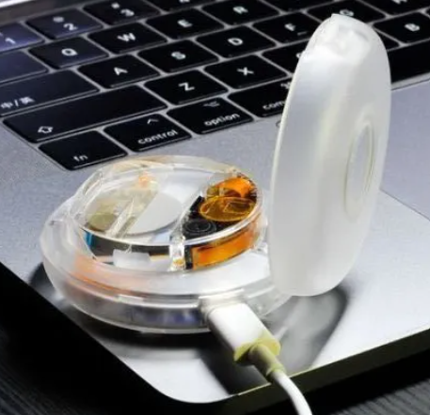
V case
the case of the glasses will have an active role by providing the internet connection and will charge the batteries to be changed to allow sufficient duration of use during the day
https://brilliant.xyz/

Slide 7
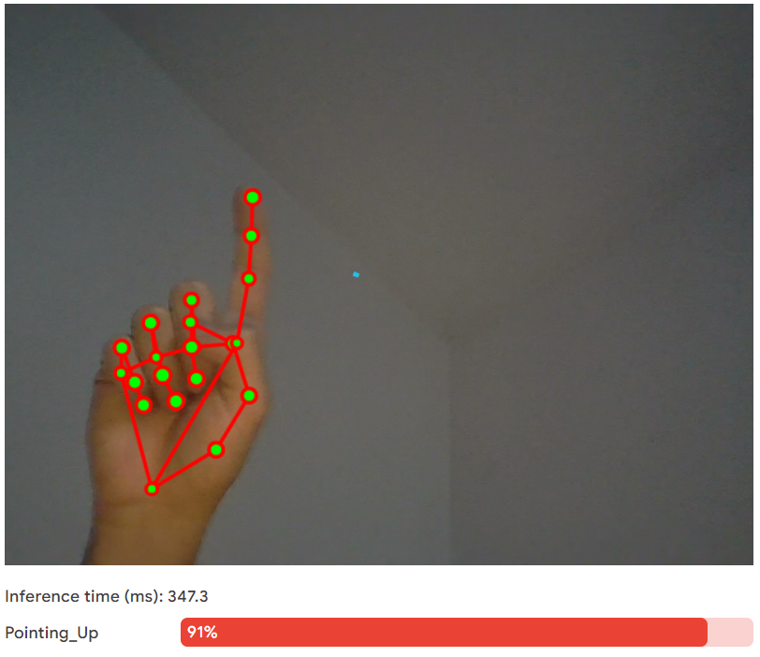
reflections and technical notes
hand tracking will be the main point for innovation and the entire interface with the OS
you can use mediapipe the google library for computer vision https://mediapipe-studio.webapps.google.com/demo/gesture_recognizer
it can run locally on the board that will be in the case like a raspberry for example

Slide 8
reflections and technical notes
the case and the esp32 on the glasses will be able to communicate even over long distances using a common web service that can run on both
the case will have the necessary sensors to have a competitive level with smartphones
the minimalist design is not very technologically explicit, they could be intended for large-scale use
the esp32 board can communicate with the display via the SPI protocol, specified by the display manufacturer

Slide 9

Simone Vetere
Alba, CN 12051 IT
+39 392 756 0000
simoneveterex@gmail.com
employee at Tesisquare, developer

